Slide 1
Focus on People with Disabilities
A companion guide to Your Money, Your Goals
Notes:
THIS PRESENTATION SUPPORTS THE MARCH 2019 VERSION OF THE FOCUS ON PEOPLE WITH DISABILITIES COMPANION GUIDE. The document will be referred to throughout this presentation as “the guide.” THE GUIDE IS ALIGNED WITH THE SEPTEMBER 2018 VERSION OF YOUR MONEY, YOUR GOALS: A FINANCIAL EMPOWERMENT TOOLKIT. This document will be referred to throughout this presentation as “the toolkit.”
Instructions for Facilitator:
Introduction to Focus on People with Disabilities guide
This PowerPoint presentation was created to train frontline staff and volunteers to use Focus on People with Disabilities to help the people they serve. Focus on People with Disabilities is a companion guide to the Your Money, Your Goals financial empowerment toolkit. It was developed by the Consumer Financial Protection Bureau (CFPB.) It contains information, tips, and tools based on the insights from people with disabilities and from organizations that serve the disability community. It is based on the core philosophy that everyone has a right to control their own money and make their own financial decisions.
This presentation includes the visual aids (PowerPoint slides) and facilitation guide (notes section of slides) necessary to conduct a training on Focus on People with Disabilities.
This training may be used without modification, but you may add selected slides and activities from the main Your Money, Your Goals presentation found on the Your Money, Your Goals web page: https://www.consumerfinance.gov/educational-resources/your-money-your-goals. To do so:
Review the Your Money, Your Goals toolkit for tools and information that you would like to cover in your training.
Review the main Your Money, Your Goals presentation for activities that will make your training interactive and help you achieve your objectives for the training.
Copy and paste the relevant slides from Steps 1 and 2 from the main Your Money, Your Goals presentation into this presentation, placing them where they fit best given the other topics you are covering.
The resulting presentation will allow you to cover tools and information from both Focus on People with Disabilities and the Your Money, Your Goals toolkit.

Slide 2
Disclaimer
The Consumer Financial Protection Bureau (CFPB) created the Your Money, Your Goals toolkit for consumers, as well as the training materials presented today. These materials are being presented to you by a local organization. The organizations or individuals presenting these materials are not agents or employees of the CFPB, and their views do not represent the views of the CFPB. The CFPB is not responsible for the advice or actions of these individuals or entities. The CFPB appreciates the opportunity to work with the organizations that are presenting these materials.
This document includes links or references to third-party resources. The inclusion of links or references to third-party sites does not necessarily reflect the CFPB’s endorsement of the third-party, the views expressed on the third-party site, or products or services offered on the third-party site. The CFPB has not vetted these third-parties, their content, or any products or services they may offer. There may be other possible entities or resources that are not listed that may also serve your needs.
Notes:
Instructions for Facilitator:
Review the standard disclaimer. Be sure to paraphrase, not read.
Briefly share information on the organization with which you are associated.
Note to facilitator: Even though this slide has a lot of text, the entire disclaimer should be included visually during the training.

Slide 3
Training objectives
Understand the content of Focus on People with Disabilities and how it complements the Your Money, Your Goals toolkit.
Know how to use the information and tools to help people with disabilities take steps to reach their financial goals.
Increased awareness of the Consumer Financial Protection Bureau’s financial education resources.
Notes:
Instructions for Facilitator:
Explain that the training objectives are those things that participants will be able to do or those things that they will know by the end of this training.
Review the objectives. Be sure to paraphrase, not read.
Understand the content of Focus on People with Disabilities and how it complements the information and tools in the Your Money, Your Goals toolkit,
Know how to use the information and tools to help people with disabilities take steps to reach their financial goals, and;
Have increased awareness of the CFPB and be able to access and refer people with and without disabilities to its resources.

Slide 4
The CFPB
An introduction to the Consumer Financial Protection Bureau
Notes:
Instructions for Facilitator:
Explain that a key goal of the training is to connect frontline staff and volunteers to CFPB resources.

Slide 5
The CFPB’s mission and vision
MISSION
To regulate the offering and provision of consumer financial products or services under the Federal consumer financial laws and to educate and empower consumers to make better informed financial decisions.
VISION
Free, innovative, competitive, and transparent consumer finance markets where the rights of all parties are protected by the rule of law and where consumers are free to choose the products and services that best fit their individual needs.
Notes:
Instructions for facilitator:
Introduce key facts about the CFPB using the following information:
The Consumer Financial Protection Bureau is a U.S. government agency.
The CFPB was established by the Dodd-Frank Wall Street Reform and Consumer Protection Act of 2010.
The CFPB is working to ensure that consumers get the information they need to make financial decisions they believe are best for themselves and their families – that prices are clear up front, that risks are visible, and that nothing is buried in fine print.
Explain that a key goal of the training is to connect frontline staff to CFPB resources, including the Submit a Complaint system.

Slide 6
People with disabilities and financial decision making
Millions of Americans with disabilities face unique financial needs or barriers.
  8% unemployment rate for adults with disabilities, more than double the national average. (Bureau of Labor Statistics, 2018)
  27% poverty rate for people with disabilities ages 18-64, compared to 12% poverty rate for adults without disabilities.
  (The Disability Statistics Compendium, 2017)
  May not have had substantial prior experience in making financial decisions that affect their lives.
These challenges—and also opportunities—make financial empowerment for the disability community especially important.
Notes:
Instructions for Facilitator:
Use the following information to present slide content:
Americans with disabilities are confronted daily with significant obstacles as they go about their lives, such as lower rates of participation in the labor force and higher rates of poverty.
People with disabilities may have unique financial needs to achieve financial empowerment, such as navigating savings and benefits or paying for assistive devices.
In addition to the challenges, there are opportunities represented by new policies and programs to help people with disabilities in their financial planning and saving.
Focus on People with Disabilities is designed to help people with disabilities navigate both those challenges and opportunities as they make financial choices.
Note to facilitator: The following are links to the statistics referenced on the slide:
Unemployment statistic for 2018, released February 26, 2019: https://www.bls.gov/news.release/disabl.nr0.htm
The printed guide refers to a previously reported rate of 9%, but the slide has been updated to 8% to reflect 2018 full year data released in February 2019.
Poverty statistic: https://disabilitycompendium.org/

Slide 7
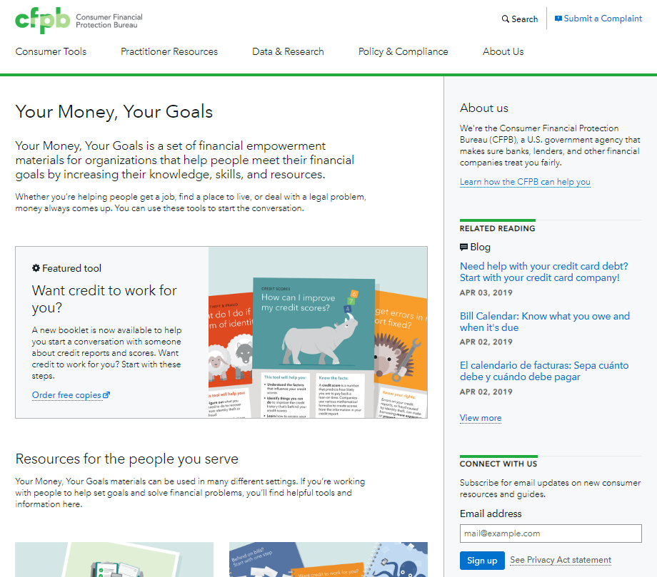
Your Money, Your Goals landing page
To subscribe for email updates on new consumer resources and guides visit: www.consumerfinance.gov/your-money-your-goals
Notes:
Instructions for Facilitator:
Explain that the image on this slide is a screenshot of the CFPB’s Your Money, Your Goals landing page.
To get to this site, visit: www.consumerfinance.gov/your-money-your-goals.
Review that this where participants can:
Download and order the Focus on People with Disabilities guide, the Your Money, Your Goals toolkit and other materials free of charge.
Sign up to receive Your Money, Your Goals email updates on new resources, trainings opportunities and other helpful information from the Your Money, Your Goals, additional training opportunities, and other important and helpful information from the CFPB.

Slide 8
Your Money, Your Goals
An orientation to the toolkit
Notes:
Instructions for Facilitator:
Use the following information to briefly explain that Your Money, Your Goals is both a toolkit and training:
The modularized toolkit has information and tools that frontline staff and volunteers can integrate into the work they do each day to help the people they serve meet their financial goals by increasing their knowledge and skills, and resources. Its modules function independently of one another and are appropriate for a wide variety of types of programs and populations.
The training is designed for frontline staff and volunteers, whether they are a social service provider, financial educator, legal aid or pro bono attorney, or a community based volunteers. The CFPB understands that they have established relationships and trust with consumers. And, that these relationships will help them reach the people they serve where they are and get them information when they need it most.

Slide 9
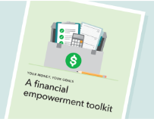
Your Money, Your Goals: Resources
Toolkit
Online resources
Booklets
  Behind on bills?
  Debt getting in your way?
  Want credit to work for you?
Companion guides
  Native Communities
  Reentry
  People with Disabilities
Notes:
Instructions for Facilitator:
Review each of the tools and resources available using the following information:
The Your Money, Your Goals toolkit has more than 240 pages of detailed information and 34 tools on an array of financial topics. The current version of the toolkit was updated in 2018 and is available in English. The previous version of the toolkit, updated in 2016, is available in Chinese and Spanish.
For use alongside the toolkit or on its own, the Focus on People with Disabilities guide includes 65 pages of specialized information, 6 tools and 3 handouts to meet the needs of people with disabilities. It is 508 compliant and compatible with screen readers.
Focus on Reentry and Focus on Native Communities are also companion guides to Your Money, Your Goals. Like Focus on People with Disabilities, they supplement the core toolkit with information and tools that are especially relevant when serving a particular group of people.
Finally, Behind on bills, Debt getting in your way and Want credit to work for you are a colorful, compact, and easy to use assortment of tools that all relate to the common challenge of making ends meet. Behind on bills is also available in Spanish.

Slide 10
Focus on People with Disabilities
Exploring the guide
Notes:
Instructions for Facilitator:
Start the in-depth review of the Focus on People with Disabilities guide.
Explain that the guide is a separate document from the toolkit. Ideally, in a training session each of the participants will have access to a printed or electronic version of the guide and the toolkit.

Slide 11
Focus on People with Disabilities contents (1 of 2)
Introduction
People with disabilities and financial decision making
Using the Your Money, Your Goals toolkit and guide
How to begin
  Tool: Starting the money conversation
Modules: Your Money, Your Goals for People with Disabilities
Additional resources
Notes:
Instructions for Facilitator:
Explain that the following two slides cover the table of contents of Focus on People with Disabilities. This is the first part of the table of contents.
The guide starts out with an Introduction section the provides information about CFPB and Your Money, Your Goals.
The section on People with disabilities and financial decision making provides important context on financial challenges within the disability community.
The Using the Your Money, Your Goals toolkit and guide section describes the types of people who may find the tools and resources helpful and lists the nine modules in the toolkit.
The How to begin section helps frontline staff and volunteers to use the toolkit and guide to discuss financial issues with the people that they work with and includes a tool entitled Starting the money conversation.

Slide 12
Focus on People with Disabilities contents (2 of 2)
  Module 1: Setting Goals
    Tool: Paying for assistive devices
  Module 2: Saving
    Tool: Setting up an ABLE Account
  Module 3: Tracking Income and Benefits
    Tool: SSI estimator
  Module 4: Paying Bills
  Module 5: Getting through the Month
    Tool: Monthly budget
  Module 6: Dealing with Debt
  Module 7: Understanding Credit Reports and Scores
  Module 8: Choosing Financial Products and Services
  Module 9: Protecting your Money
    Tool: Identifying financial abuse and exploitation
  Additional resources
Notes:
Instructions for Facilitator:
Explain that the next section in the table of contents is the heart of the Focus on People with Disabilities. It is entitled Modules: Your Money, Your Goals for People with Disabilities. It mirrors the nine modules of the Your Money, Your Goals toolkit. This slide lists the nine modules and each of the tools in Focus on People with Disabilities. The nine modules are:
Module 1: Setting Goals. This includes a tool on “Paying for assistive devices”.
Module 2: Saving. This includes a tool on “Setting up an ABLE Account”.
Module 3: Tracking Income and Benefits. This includes an “SSI estimator” tool.
Module 4: Paying Bills.
Module 5: Getting through the Month. This includes a “Monthly budget” tool.
Module 6: Dealing with Debt.
Module 7: Understanding Credit Reports and Scores.
Module 8: Choosing Financial Products and Services.
Module 9: Protecting your Money. This includes a tool on “Identifying financial abuse and exploitation”.
Explain that each of these modules provides information on the topic that is relevant to people with disabilities. There are five tools that help to apply that information to real life situations. The tools in Focus on People with Disabilities can be printed out and filled out by hand or can be filled out electronically using the online version available on the Your Money, Your Goals webpage www.consumerfinance.gov/your-money-your-goals.
Explain that the last section—Additional resources—provides a list of where to go for help when a person needs assistance with: benefits, health care bills, housing or paying utility bills, dealing with debt, finding a lawyer, getting a bank or debt collector to respond, and finding a job.

Slide 13
How to begin
Resources for having the money conversation
Introductory information about Your Money, Your Goals
  Information on financial empowerment
  Tips and scripts for starting the money conversation
Focus on People with Disabilities, Tool: Starting the money conversation
Notes:
Instructions for Facilitator:
Explain that the introduction section in the toolkit and the How to begin section in the guide both offer tips and resources to help discuss financial issues and decision-making with the people you serve. In this section, and throughout the guide, you will find specific tools for the disability community and suggestions of tools in the main toolkit that may be useful. The Financial Empowerment Self-Assessment (in the toolkit on page 14) may be helpful in understanding your own financial know-how and how you approach financial decision-making.
Explain that Focus on People with Disabilities includes a tool entitled “Starting the money conversation” on pages 10 and 11 of the guide. It’s an easy to use questionnaire designed for service providers to understand each person’s goals and financial situation.
Describe the purpose of this tool. Here is how you can explain it:
The tool provides suggested tips and scripts for service providers to start the money conversation with the person they serve.
This questionnaire is designed for the person to zero in on the information and tools that will be most useful for them.
The questionnaire is only intended to be shared with you and the person you’re working with.
When you feel the time is right, you can simply ask the person you’re working with to complete the questionnaire.
The CFPB does not collect this information.

Slide 14
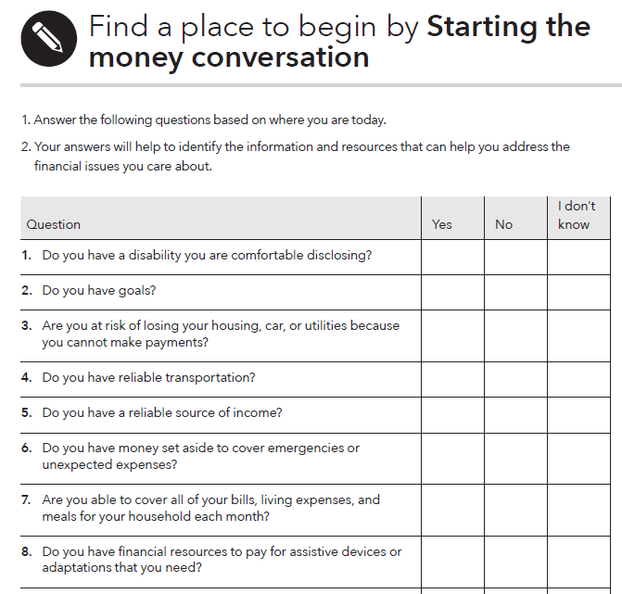
Tool: Starting the money conversation
Help identify financial challenges.
Help zero in on the information and tools that will be most useful to them.
Help you determine where to start the financial empowerment discussion.
Notes:
Instructions for Facilitator:
This is an image of the “Starting the money conversation” questionnaire.
You will notice that each tool on the guide has a circular symbol at the top. It is a pencil inside a circle to show that the tools can be completed with or by the people you serve.
Review the contents of the “Starting the money conversation” questionnaire on page 11 in Focus on People with Disabilities. It is designed to help service providers ask the people they serve to complete as a way to begin the money conversation.
Be sure to explain that using this questionnaire is not mandatory. The CFPB does not collect this information. It is a tool frontline staff and volunteers can use to more effectively and efficiently match a person’s needs with information and tools in the toolkit and guide. Because the questionnaire is simple and only has a few questions, they may be able to gather the information by simply talking it through with the person they serve.
Explain that this is an image of the first half of tool. The entire tool includes the following 13 questions:
Do you have a disability you are comfortable disclosing?
Do you have goals?
Are you at risk of losing your housing, car, or utilities because you cannot make payments?
Do you have reliable transportation?
Do you have a reliable source of income?
Do you have money set aside to cover emergencies or unexpected expenses?
Are you able to cover all of your bills, living expenses, and meals for your household each month?
Do you have financial resources to pay for assistive devices or adaptations that you need?
Do you owe a person, business, or the government money?
Have you been unable to get a loan, credit card, apartment, car, or job due to a bad credit record?
Do you have a checking or saving account at a bank or credit union?
Do you think your identity has been stolen? Have you experienced fraud?
Do you make the decisions about your financial resources or feel like you have control over your finances?

Slide 15
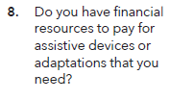
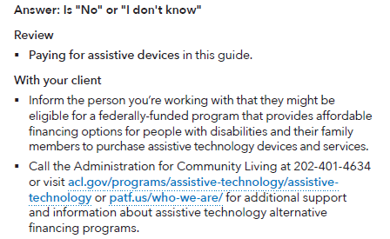
Tool: Starting the money conversation, response key
Use to analyze responses
Determine where to start the financial empowerment discussion
Notes:
Instructions for Facilitator:
Explain the analysis procedure for “Starting the Money Conversation”. Here is how you can explain it:
The questionnaire results will help you and the person you’re working with to navigate the guide to access relevant information, tools, or referrals.
For example, if the individual answers “no” or “I don’t know” to Question 8 – “Do you have financial resources to pay for assistive devices or adaptations that you need?” – The response key in the chart suggests that you can respond by reviewing the “Paying for assistive devices” tool in the Focus on People with Disabilities and also sharing information on financing options available through federal, state, and local programs.

Slide 16
Modules: Your Money, Your Goals for People with Disabilities (Modules 1-9)
Notes:
Instructions for Facilitator:
Briefly explain that the next section starting on page 17 in Focus on People with Disabilities is entitled Modules: Your Money, Your Goals for People with Disabilities. The content of this section aligns with the nine modules in the Your Money, Your Goals toolkit. The guide provides a brief overview of each module, disability-specific information about the topic of the module, and—for some modules—new disability-specific tools.
In some cases, the associated 6 tools in Focus on People with Disabilities are redesigned versions of the tools in the Your Money, Your Goals toolkit that have been adapted to address issues specific to the disability community. In other cases, the tools are new. The guide contains 3 handouts with specialized information.

Slide 17
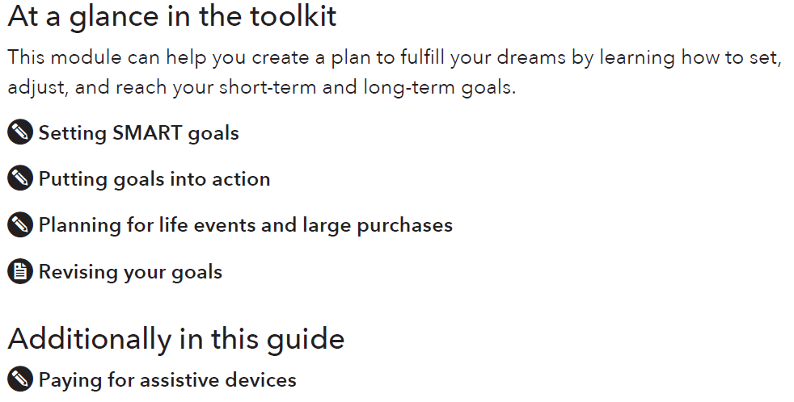
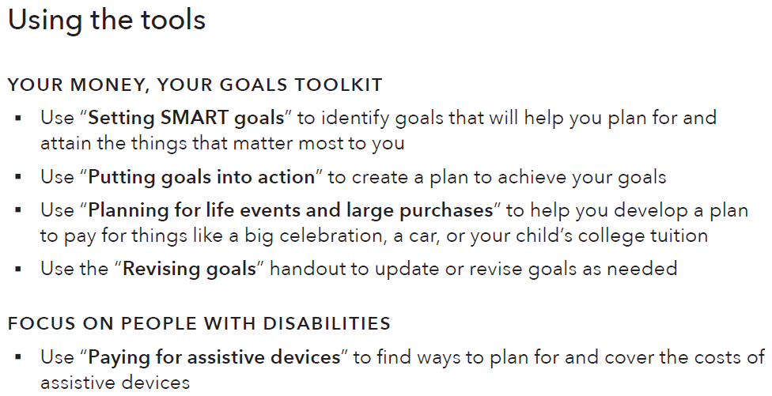
Format of the modules
Notes:
Instructions for Facilitator:
Explain that each module follows the same format.
Each module begins with At a glance in the toolkit. This lists the tools that can be found in the main toolkit that are related to the information in this module. The section called Additionally in this guide lists the tools that have been developed with a particular focus on the disability community and these are found in the guide.
Each module includes an overview section and a section called Focus on people with disabilities. These sections describe the content in the module in greater detail, and they include examples to show how the topic of the module can be helpful to the disabilities community.
Each module ends with a section on Using the tools. This will give you ideas and examples of how to incorporate the tools into your work.

Slide 18


Navigating the modules
Tool
Handout
Notes:
Instructions for facilitator:
The words “tool” and “handout” do not appear in the titles of the tools/handouts.
The toolkit uses icons to indicate a tool or a handout.
Explain the difference between a tool and a handout.
A tool involves actions that the user can take. There are fields that need to be filled out. Tools are best used in a facilitated conversation between a frontline staff person and the person they’re helping.
A handout is an informational brochure. It has good tips and information for someone to take home with them. It doesn’t require any immediate action or a facilitated conversation.
Here, ask participants to flip through pages 17 through 21 in the guide to see the format and organization of Module 1. The corresponding content in Module 1 of the toolkit begins on page 24.

Slide 19
Module 1: Setting Goals
Setting goals is an essential part of the foundation for achieving self-sufficiency. Goals can also help people plan how to use their money.
Examples of large goals:
  Paying for assistive devices
  Buying a car
  Paying for adaptations to vehicles
  Paying medical expenses
  Renovating your home
  Paying for training or post-secondary education
Specific, Measurable, Able-to-be-Reached, Relevant and Time bound (SMART) Goals
Notes:
Instructions for Facilitator:
Introduce Module 1: Setting Goals on page 17 in Focus on People with Disabilities.
Briefly describe the benefits of setting goals.
Goals can provide direction for life.
Setting goals is an essential part of the foundation for achieving self-sufficiency.
Goals can also help people plan how to use their money.
Explain the purpose of Module 1. This module can help people plan for both life events and large purchases. Examples of large purchases may include:
Paying for assistive devices
Buying a car
Paying for adaptations to vehicles
Paying medical expenses
Paying for training or post-secondary education
Explain that in the Your Money, Your Goals toolkit, this module describes and uses the SMART approach to developing goals.
SMART is an acronym. SMART goals are Specific, Measurable, Able-to-be-reached, Relevant, and Time bound.
This module also suggests ways to talk to people about turning their financial hopes, wants and dreams into SMART goals.

Slide 20
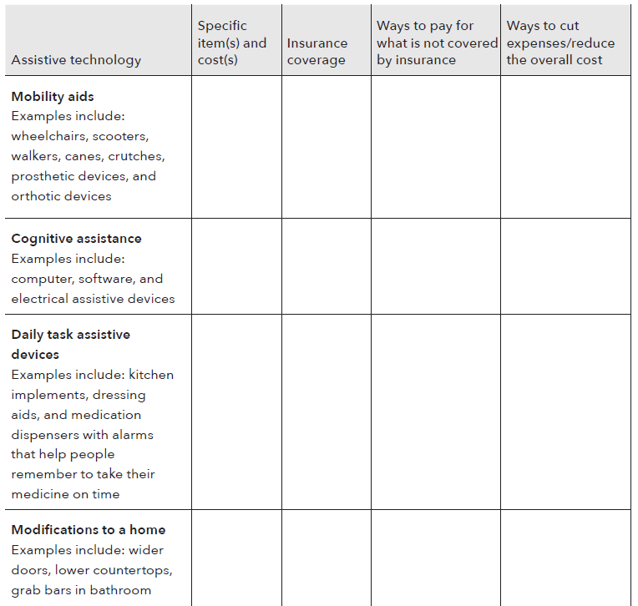
Tool: Paying for assistive devices
Notes:
Instructions for Facilitator:
Module 1 includes a tool on “Paying for assistive devices” on page 19 in Focus on People with Disabilities.
Explain that for many people with disabilities, assistive devices may help the person achieve independence so they can reach their other goals. Assistive devices may be large purchases, requiring more money than a person can reasonably expect to have available at one time after covering their basic living expenses.
Review how to use this tool. Use this tool to help someone identify the assistive devices they need or want, how to reduce the costs, and how to pay for these items.
Explain how to complete this tool using the following instructions:
Read through the first column to identify your assistive technology needs.
Next, research the cost of each device or service and enter that information into the column for “specific items and costs.”
In the third column, enter how much of the cost would be covered by your health insurance. If you have health insurance, prior authorization may be required.
In the fourth column, identify other potential ways to pay for the items.
Finally, in the fifth column, identify ways to keep the costs as low as possible. You may qualify for a federally-funded Alternative Financing Program that provides affordable financing to purchase assistive technology. Contact your local department of rehabilitation or visit the U.S. Department of Health and Human Services, Administration for Community Living at www.acl.gov for additional support and information.

Slide 21
Module 2: Saving
Saving is about setting aside resources today so they can be used in the future. It’s about balancing your resources to take care of your family and community.
Discuss the importance of:
Finding a safe and secure place for savings
How covering emergency needs with savings can save money
How to build up savings
Savings, benefits, and asset limits
Notes:
Instructions for Facilitator:
Introduce Module 2: Saving on page 22 in Focus on People with Disabilities.
Explain that saving is about setting aside resources today so they can be used in the future.
Use this module to help people save.
This module provides information on how to build up savings and do so in a stable, worthwhile manner.
It also touches on savings and benefits, and the asset limits that are often important to people with disabilities.
Additional information and tools in the Your Money, Your Goals toolkit designed to help a person understand the importance of setting aside money today into a place that is safe and secure for use in the future.

Slide 22
Building savings while receiving public benefits
For many people with disabilities who receive public benefits, saving may not seem to be an option that’s available to them. This is because some benefit programs may have “asset limits.”
There are savings options for individuals with disabilities that do not impact the asset limits associated with SSI, Medicaid, or other benefits.*
  Achieving a Better Life Experience (ABLE) Accounts
  Plans to Achieve Self-Support (PASS)
  Special needs trusts and pooled trusts
  * These options are complicated and you may need more information after using this introductory summary.
Notes:
Instructions for Facilitator:
Use the following information to present the slide content:
For many people with disabilities who are receiving public benefits, saving may not seem to be an option that’s available to them. This is because when people receive public benefits, some benefit programs have “asset limits.”
Asset limits cap the amount of savings and other resources somebody can have and still maintain eligibility for public benefits. When a program has asset limits, savings may impact a person’s eligibility for that type of assistance.
There are saving options, however, that do not count against these asset limits.
Focus on People with Disabilities discusses three potential ways people with disabilities can save while they receive public benefits like Supplemental Security Income – SSI – Medicaid or other benefits. Each of these ways to save can be complicated; the goal is to flag them so that the person knows where to start to do additional research.
There are other ways to save; these are just three important options:
Achieving a Better Life Experience Account, or ABLE Account for short
Plans to Achieve Self-Support, or PASS for short, and
Special needs trusts and pooled trusts
Review the ABLE Account program in more depth in the next few slides. For specifics on special needs trusts, pooled trusts, and the other programs, start by consulting the Social Security Administration at www.SSA.gov.

Slide 23
Achieving a Better Life Experience (ABLE Act) Account
Important new resource for people with disabilities
Savings in an ABLE Account does not affect eligibility for:
  Supplemental Security Income (SSI)*
  Medicaid and other federal means-tested benefits*
ABLE Account programs are established and maintained by individual states. An eligible person can open an account:
  In their own state, if a program exists
  In any state program that accepts out of state residents.
  * Benefits issues are complicated and individuals should consult a specialist familiar with their situation before making decisions that could affect benefits.
Notes:
Instructions for Facilitator:
Use the following information to introduce ABLE Accounts on pages 24 through 29 in Focus on People with Disabilities:
ABLE Accounts are an important new resource for people with disabilities.
With the passage of the Stephen Beck Jr., Achieving a Better Life Experience Act of 2014, ABLE Accounts have become a new way for people with disabilities to save.
In general, people with disabilities may be limited in how much they can save in assets without it affecting their Supplemental Security Income or SSI or Medicaid. ABLE Accounts, though, allow certain people with disabilities to save much more and still keep their vital benefits – giving them more independence and financial empowerment. Within limits, savings in ABLE Accounts do not affect eligibility for:
Supplemental Security Income, known by the acronym SSI, or for
Medicaid and other federal means-tested benefits
Beginning on page 24, Focus on People with Disabilities includes specifics on those important limits as well as eligibility requirements and other details.
ABLE Account programs are established and maintained by individual states.
An eligible person can open an account in their own state if the program exists or in any state program that accepts out-of-state residents.
For additional information, including a complete list of available ABLE Account programs visit the National ABLE Resource Center at: www.ableNRC.org.

Slide 24
Tool: Setting up an ABLE Account
Ask these questions to determine if an ABLE Account is an option for you.
  Do you meet the eligibility requirements?
  Do your goals match the qualified disability expenses allowed that can be paid from an ABLE Account without incurring taxes?
  Do you have the minimum contribution required to open an account?
  Can you to continue to make contributions to the ABLE Account once it’s opened?
Fill in the worksheet on the next page to compare features of different plans if you determine you would like to open an ABLE Account.
Notes:
Instructions for Facilitator:
Module 2 includes a tool on “Setting up an ABLE Account” on page 28 in Focus on People with Disabilities.
Review the “Setting up an ABLE Account” tool.
This tool can be used to help a person understand what an ABLE Account is and, if they want to open one, some of the things they may want to consider as they decide between their options.
The tool provides instructions for two steps to take when exploring the possibility of setting up an ABLE Account:
First, help the person to respond to four key questions to determine if an ABLE Account is an option for them. Look through the tool on page 29 in Focus on People with Disabilities to see how the tool deals with each of these topics. This slide lists the following four general topics that the first part of the tool helps people with disabilities to explore :
eligibility
personal goals
the minimum contribution to open the account, and
ongoing contributions
Second, if a person decides that an ABLE Account is an option for them, work with them to fill in the second part of the tool. That worksheet helps a person compare two ABLE Account programs side-by-side.
For a list of available ABLE Account programs and details about how they operate, visit www.ableNRC.org.

Slide 25
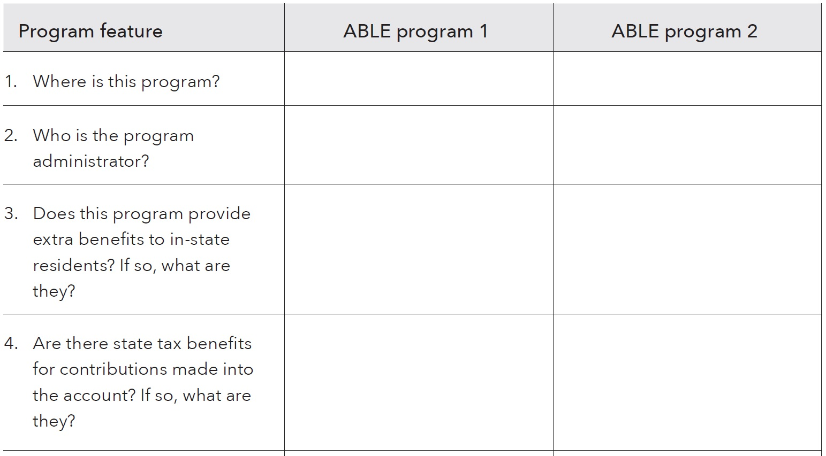
Tool: Setting up an ABLE Account
Notes:
Instructions for Facilitator:
Review the worksheet part of the “Setting up an ABLE Account” tool on page 30 in Focus on People with Disabilities. It provides a way to compare ABLE Account programs and their many features.
Explain that this screenshot of the ABLE tool worksheet shows the first half of the tool and how it can be used to compare programs features. Here is how you can explain it:
The table includes 3 columns: “program feature,” “ABLE program 1,” and “ABLE program 2.” This image shows the first four questions, but the entire tool includes the following 10 questions:
Where is this program?
Who is the program administrator?
Does this program provide extra benefits to in-state residents? If so, what are they?
Are there state tax benefits for contributions made into the account? If so, what are they?
Does this program offer various savings and investing options? If so, what are they?
Are there fees for keeping the account open? If so, what are they?
Are there limits or fees on disbursements from the account? If so, what are they?
Does this program offer a debit card? If so, what is the fee to use it?
Does the program offer check writing?
Are there other features that are important to you?
Work with the person to compare ABLE Account features side-by-side in a way that helps them decide which program is best for their situation.

Slide 26
Module 3: Tracking Income and Benefits
For many people with disabilities, tracking income may mean tracking their benefits payments.
  Income: Regular income, irregular income, seasonal, one-time occurrences
  Benefits: Supplemental Security Income (SSI), Social Security Disability Insurance (SSDI), others
Visit the Social Security Administration at www.ssa.gov.
Notes:
Instructions for Facilitator:
Introduce Module 3: Tracking Income and Benefits on page 31 in Focus on People with Disabilities.
Use the following information to introduce Module 3:
This module in the guide and toolkit discusses ways to receive and track income and benefits. This is especially important because:
Helping people track their income and spending can help them identify whether they are on track to achieve their financial goals.
For many people with disabilities, tracking income may mean tracking their benefits payments.
Individuals may receive income from work: Regular income, irregular income, seasonal income, one-time occurrences of income.
There are many types of benefits that provide income. These may include Supplemental Security Income (SSI) or it may include Social Security Disability Insurance (SSDI) or Social Security retirement benefits, and others. The types of benefits an individual may be eligible for may have different rules so it is important to look at each individual’s situation.
Because earnings can offset and reduce benefits, some people with disabilities don’t believe they can work without making themselves worse off financially. However, in many situations this is not the case – and earning money can increase income overall. This is an important point to make.
The Social Security Administration has many programs designed to facilitate the goal of work and may include continuation of benefits. For more information on these programs, visit the Social Security Administration at www.ssa.gov.

Slide 27
Using the “Income and benefits tracker”
A first step is tracking income and financial resources.
Use this tool to help a person you serve understand the amounts and timing of their financial resources and income.
Encourage the person you serve to track their income and financial resources for a day, a week, two weeks, or a month.
It may be the first time they understand where they get their money and how much they have to work with.
Notes:
Instructions for Facilitator:
Module 3 includes the “Income and benefits tracker” on page 67-68 in the main toolkit.
Have participants turn to pages 67-68 in the main toolkit.
Explain that this tool is intended to help people understand what resources they have and plan the best times to save and spend. It is important to include benefits, even those that can only be used for certain types of purchases.
Use the following information to describe the benefits of using the tool:
Use this “Income and benefits tracker” to help a person understand the amounts and timing of their income.
Encourage the person to track their income and financial resources for a day, a week or a month, which can help them understand their income flows.
This can be very empowering for people. It may be the first time they understand where they get their money and financial resources, and how much they have to work with as they plan their spending or savings.
Note to facilitator: It’s important to explain the difference between gross and net income for the purposes of tracking income and creating a budget.
If somebody is working 20 hours per week at $15 per hour, their gross income is $300 per week – but after taxes, they may only take home $250 or less in net income. It’s good to list net income in this tracker so that the individual doesn’t run the risk of over-spending when they build their budget.

Slide 28
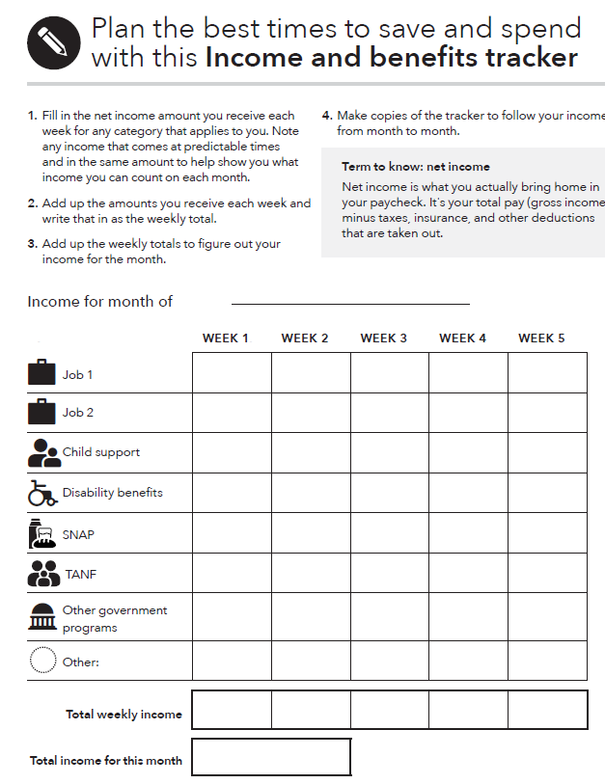
Tool: Income and benefits tracker
What to do:
Gather all of your pay stubs, benefits statements, and records of electronic payments.
Enter the amount of income or benefits you receive next to the correct category in the appropriate week of the month.
Notes:
Instructions for Facilitator:
Explain that the “Income and benefits tracker” is a tool that can be useful for anyone who is starting to track income and benefits. The tool is intended to help people understand what resources they have and plan the best times to save and spend. It is important to include benefits, even those that can only be used for certain types of purchases.
Tracking income and benefits can be very empowering for people. It may be the first time they understand where they get their money and financial resources, and how much they have to work with as they plan their spending or savings.
Instructions for facilitator on presenting the tool:
Explain how to use the “Income and benefits tracker.”
Review the categories included. The rows in the tracker include Job 1, Job 2, Child support, Disability benefits, SNAP, TANF, Other government programs, and an open row for “other” expenses.
Distinguish between income and benefits. While income (like from a job) can be used to pay for anything, some benefits can only be used for a particular purpose, like food or medical costs.
Define “net income” using the information in the grey call-out box in the tool (page 68)
Net income is what you actually bring home in your paycheck. It's your total pay (gross income) minus taxes, insurance, and other deductions that are taken out.
Explain that users should record net income, not gross income, in the tracker.
Ask participants if they feel there are major categories missing. (Explain the tradeoff between many categories and utility of the form.)
FACILIATION TIP: Download this tool from the CFPB website in advance of your training and demonstrate the automatic calculation feature.

Slide 29
Using the “SSI estimator” tool
Use this tool to help a person with a disability understand how earnings from work affect their SSI benefit.
Go through each point in the tool and work out the math with the person you are serving.
First, when a person earns money through a job, they keep the first $85 of their pay without any impact on their SSI. For every dollar they earn after that, SSI drops by 50 cents.
Many people think that getting paid at a job could result in stopping their SSI check, but that is not necessarily true.
In general, the more a person works, the more they make overall, even when receiving SSI.
Notes:
Instructions for Facilitator:
Explain that Module 3 includes the “Supplemental Security Income (SSI) estimator” tool on pages 33 – 34 in the guide.
Review how to use this tool. Here is how you can explain it:
This tool is designed to help a person with a disability understand how earnings from work affect their SSI benefit.
This tool is important because many people with disabilities receive Supplemental Security Income, or SSI. Some people who receive SSI may think that they cannot work at all – or don’t understand exactly how working will change their monthly benefit.
It is important to show the “SSI estimator”, because some people may think that getting paid at a job will stop their SSI check, but that’s not necessarily true.
For example, when a person earns money through a job, they keep the first $85 of their pay without any impact on their SSI. For every dollar they earn after that, SSI drops by 50 cents.
Go through each point in the tool and work out the math with the person you are serving.
By showing a person with disabilities this tool it can help them understand the connection between work and benefits – and how income may go up as they pursue a job and work.

Slide 30
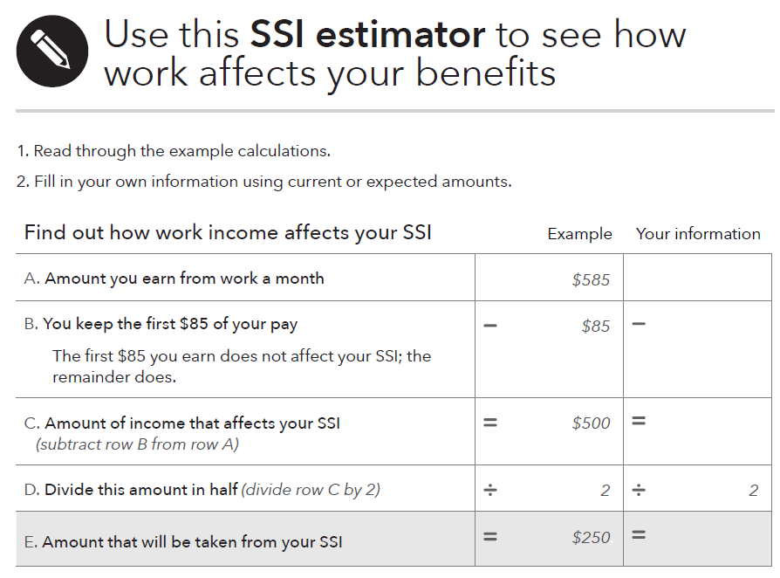
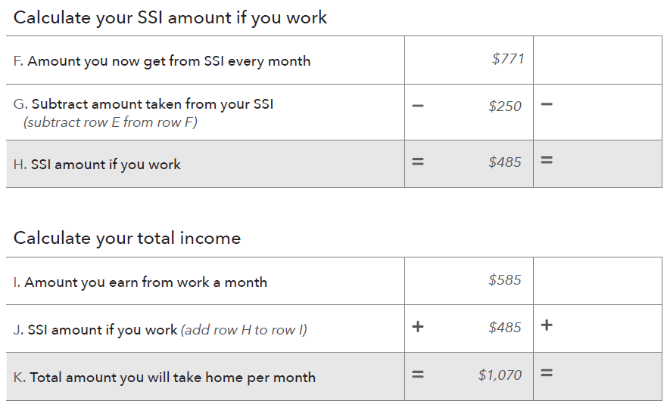
Tool: SSI estimator
Notes:
Instructions for Facilitator:
This is an image of the “SSI estimator” tool on page 34 in the guide.
Review how to use the tool. Here is how you can explain it:
The “SSI estimator” has 3 sections:
Find out how work income affects your SSI
Calculate your SSI amount if you work
Calculate your total income.
The 3 sections work as separate equations to show how more work can mean more income, even on SSI. The tool itself shows a formula and an example, and then provides space to enter the individual’s income goals to estimate the impact on their SSI amount.
IMPORTANT NOTE: There are two errors in the example calculation on this page in the printed guide. These are corrected in the downloadable online version.
Before describing the calculation, explain that:
In row H, the SSI amount if you work, the number 485 should be replaced with 521.
In row J, the SSI amount if you work, the number 485 should be replaced with 521.
In row K, the total amount you will take home each month, the number 1,070 should be replaced with 1,106.
To explain how the tool works, you can say:
The first section, “Find out how work income affects your SSI,” uses a simple equation. Complete these steps:
At the top, write down the amount earned from a month of work.
Next, subtract $85. This is because the first $85 you earn does not affect your SSI at all – but the rest of the income will.
The total after subtracting $85 will equal the “amount of income that affects your SSI.”
Divide that new amount in half. This is because every dollar earned is reduced by $.50.
The “Amount of income that affects your SSI” divided by two will be the “amount that will be taken from your SSI.”
The table uses a quick example: somebody earns $585 from work. Subtracting $85 leaves $500 as the “amount of income that affects your SSI.” Dividing that number in two means that somebody will have $250 deducted from their SSI.
The next section, “calculate your SSI amount if you work,” is pretty simple.
Take the amount that you now get from SSI every month and subtract the “amount taken from your SSI” that was calculated in the first section.”
In the example, $771 should be the amount of the you now get from SSI each month, and $250 is the amount to be deducted. The new SSI amount the person would receive is $521 per month.
Finally, to calculate the person’s total income, just add up the amount they earned from work per month and their new SSI amount.
In the example, the person earns $585 per month and has an SSI amount of $521 per month, for a total monthly income of $1,106 per month.
The person was only earning $771 in SSI before they started working – but with the additional $585 per month in wages, they now earn $1,106 per month before tax.

Slide 31
Handouts with specialized information
Workforce Investment Opportunity Act (WIOA)
WIOA provides opportunities for people with disabilities because key provisions of the Act strengthen services to youth and adults with disabilities.
The role of a representative payee
A representative payee is a person or an organization. The Social Security Administration may appoint a payee to receive the Social Security or SSI benefits for anyone who can’t manage or direct the management of their benefits.
Notes:
Instructions for Facilitator:
Present the slide content.
Explain that Module 3 in the guide also includes two handout sections on pages 35 through 37.
You will notice that each handout has a circular symbol or icon at the top. It shows a piece of paper inside a circle to note that you may want to print paper copies to have handy to give out to people who want detailed information about this topic.
The two handouts in this module provide information about the Workforce Investment and Opportunity Act, and Representative payees. These represent two very different aspects of income and benefits, but both can be important for people with disabilities and their families. Both provide opportunities and support for people with disabilities.
The Workforce Investment Opportunity Act, or WIOA for short [pronounce wee-OH-ah], provides new opportunities for people with disabilities because key provisions of the Act strengthen employment training services to youth and young adults with disabilities and require financial literacy training.
Representative payees work with people with disabilities as they receive and manage their income. In some cases, you may work with a representative payee as you work with the person with a disability. The guide on page 36-37 provides specifics on the role of representative payees.
For more information on both of these topics, visit these sections beginning on page 35 in the guide.

Slide 32
Module 4: Paying Bills
Spending
Money you use to pay for a wide range of basic needs, your financial obligations, and other things you may want.
The way people use their money is often a reflection of their values. When it comes to how the people you serve spend their money, it helps to avoid implying your own personal values and judgement.
Notes:
Instructions for Facilitator:
Introduce Module 4: Paying Bills on page 38 in the guide.
This module provides tools to track spending, strategies for cutting expenses, prioritizing bills, and more.
Briefly describe spending.
What is spending? Well, spending is money you use to pay for a wide range of basic needs, your financial obligations, and other things you may want.
It’s important to note that the way people use their money is often a reflection of their values. When it comes to how people spend their money, it is very important to avoid projecting your own personal values and judgement.

Slide 33
Module 4 (continued)
Depending on circumstances, some people with disabilities may have had limited choices in how to spend their money:
This could be because of age. For example, if the person is a minor, a parent or guardian may play a role in financial decision making.
In other circumstances, a trustee, family member, or representative payee may play a role in financial decision making.
Notes:
Instructions for Facilitator:
Use the following information to present the slide content:
Depending on circumstances, some people with disabilities may have had limited choices in how to spend their money.
This could be because of age.
If the person is a minor, a parent or guardian may have made their spending decisions.
In some circumstances, use of income may be, or have been, controlled by a trustee, family member, or representative payee.
In Module of 4 of the toolkit, starting on page 81, you can find 5 tools related to spending, such as the “Spending tracker”, “Bill calendar” and other tools that help people to cut expenses and prioritize which bills to pay first.

Slide 34
Using the “Spending tracker”
Use this tool to help a person you serve understand how they spend their money.
Encourage the person you serve to track their spending for a day, a week, two weeks, or a month.
With this information, they may realize where their money goes for the first time.
They can then make changes to how they spend their money.
The way a person tracks how they spend their money and financial resources does not matter. They should use whatever is most comfortable.
Notes:
Instructions for Facilitator:
Module 4 includes the “Spending tracker” on pages 81 through 83 in the toolkit.
Introduce the “Spending tracker”.
It designed to help a person understand how they spend their money.
Use this tool to encourage a person to track their spending for a day, a week, two weeks, or a month.
Briefly describe how to use this tool. Here is how you can explain it:
Tracking your use of money is a first step to financial empowerment. This means recording everything you spend money or financial resources on.
This information will help you understand how you use your money and financial resources.
You will also be able to make decisions about using your resources. For example, if you have a goal you want to save money for, you can decide where to cut back your spending to free up money for that goal – whether the goal is buying a new car or simply putting away more money in an ABLE Account.
The way you track how you spend your money and financial resources does not matter. You should use whatever is most comfortable and works best for you. For example, you can try to:
Write your spending into the spending tracker.
Ask someone else to write your spending into the spending tracker.
Keep receipts of every time you use money and then filling in the spending tracker using the information from your receipts.
Record a voice memo each time you spend money and have it written into the spending tracker at the end of a day or week.
Take pictures of what you spend your money on and have that written into the spending tracker at the end of a day or week.
Use a smart phone application to track your spending.

Slide 35
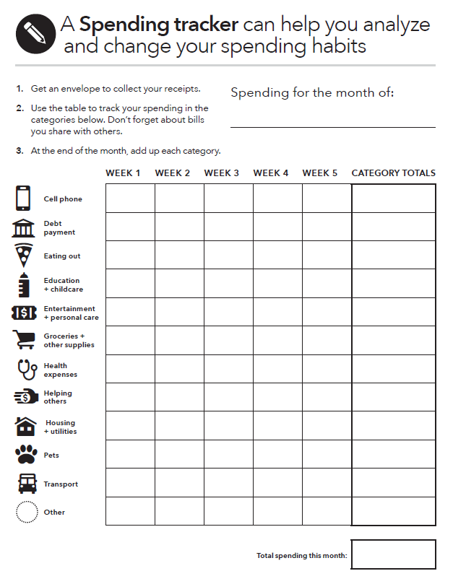
Tool: Spending tracker
What to do:
Get a small container or envelope. Every time you spend money, get a receipt and put it into the case or envelope.
Analyze your spending. Go through your receipts and enter the total you spent in each category for each week.
Notice trends. Identify any areas you can eliminate or cut back on—these will generally be wants.
Notes:
Instructions for Facilitator:
This is an image of the “Spending tracker” on pages 81-83 in the toolkit.
Review the instructions for how to use the tool. Here is how you can explain it:
Get an envelope to collect your receipts.
Use a table to sort your spending into the categories below. It notes not to forget about bills shared with others, such as electricity or other utility bills.
At the end of the month, total up each category – and then the entire total for the month, for all categories.
The tracker itself is a tool with many spending categories and 6 columns -- weeks 1-5 - and “category totals.” Use this to track how much was spent in the past month, or what the individual’s expected spending will be for the future month – and what could be adjusted. The categories that are included in the tool are:
Cell phone
Debt payment
Eating out
Education and childcare
Entertainment
Groceries and other supplies
Health expenses
Helping others
Housing and utilities
Pets
Transport
Other
Though many spending categories are essential, some expenses are “discretionary,” where an individual can choose to spend or not. If a person’s income and spending tracker suggests they need to cut back spending, discretionary areas may be a good first option. Random expenses that don’t fit into the pre-set categories can be put in the “other” section.

Slide 36
Module 5: Getting through the Month
Module 5: Getting through the Month in the Your Money, Your Goals toolkit brings together the income and spending trackers from Modules 3 and 4 to help create a cash flow budget.
The cash flow budget tools let individuals see how much money comes in and where it goes out in spending.
The tools also demonstrate how people can make changes in the timing of spending to ensure financial resources and spending are balanced.
Notes:
Instructions for Facilitator:
Introduce Module 5: Getting through the Month on page 40 in the guide.
This module discusses on how to coordinate the timing of money coming and money going out.
This is referred to as managing cash flow.
In the Your Money, Your Goals toolkit you’ll find specific tools to create a cash flow budget.
The cash flow budget tools help individuals track the flow of their income to see where and when they receive income and need to spend it. The tools demonstrate how to make changes in the timing of spending to ensure financial resources are there when they’re needed.

Slide 37








Exercise: Needs, wants, obligations
Needs
Obligations
Wants
Notes:
Exercise: Needs, Wants, and Obligations
Review the definition of spending.
Review the definitions of needs, wants, and obligations:
Needs are things you must have to live.
Wants are things you can survive without.
Obligations are things you must pay because you owe someone money (a car loan) or have been ordered to pay someone (child support).
Tell people you are going to read off a list of items that you could spend money on. Use the list of example expenses below or use others that may be more contextually or culturally relevant to the people you are training. Limit the number of examples to 4 – 6.
Ask participants to “vote” for the what best represents the category they would put that item in: need, want, or obligation. Depending on the preferences of your group—especially any issues related to a disability—choose a voting method that works for everyone. Options include:
Making the noise of a different barnyard animal (e.g., pig = want, cow = need, goat = obligation).
A poll facilitated by one of the free online polling services that are available. People vote using their phone and the results appear on the screen or wall you are projecting on.
Raised hands. This requires that, for each example expense (see below), you ask the group “How many of you think this is a want?” “How many think it is a need?” “How many think it is an obligation?”
After you read each item, facilitate a discussion to uncover the reasons people have voted the way they have.
Be sure to ask questions like:
What are some of the reasons you see the item as a need? Want? Obligation?
What could be some of the reasons people see the same item so differently?
How does this relate to your work with people?
Example expenses:
Education and childcare
Entertainment and personal care,
Cell phone, including data plan
Eating out (represented by a slice of pizza),
Debt payment,
Pet food
Helping others
Groceries and other supplies
Rent
Savings for vacation
Paper towels
Personal grooming related expenses
Bottled water
Coffee (the kind you make at home)
Home-based Internet connection

Slide 38
Module 5 (continued)
Budgeting can help a person with or without disabilities gain and maintain control over their money.
Module 5 provides information and tools to help people make plans to get through the month – pay for all of their living expenses, bills, financial obligations, and other uses of income or financial resources, including saving.
For a person living on a fixed-income, a monthly budget can help them manage their income, benefits, and plan for their expenses.
Notes:
Instructions for Facilitator:
Present the slide content.
Budgeting can help a person with and without disabilities gain and maintain control over their money.
Module 5 provides information and tools to help people make plans to get through the month – pay for all of their living expenses, bills, financial obligations, and other uses of income or financial resources, including saving.
For a person living on a fixed-income, a monthly budget can help them manage their income, benefits, and plan for their expenses.

Slide 39
Using the “Monthly budget” tool
Using a monthly budget can be empowering. It can help a person plan how to use their financial resources to support themselves and their family and save for their future.
This tool can be used to help manage their income and benefits and plan for expenses.
Start by asking about a person’s monthly income, benefits, and expenses.
Once these questions are answered, the information can be used to create a simple monthly budget.
Notes:
Instructions for Facilitator:
Module 5 includes a “Monthly budget” tool on pages 42-43 in the guide.
Use the following information to introduce the “Monthly budget” tool:
Using a monthly budget can be very empowering: it can help a person plan how to use their financial resources to support themselves and their family and save for their future.
This tool can be used to help individuals manage their income, benefits and plan for their expenses. It can also be a resource to adjust any spending or income in the future to create a more balanced financial situation, and save more moving forward.
Start by asking the person about their monthly income, benefits, and expenses. They may have already marked these down in the income tracker and spending tracker tools available in Modules 3 and 4 in the toolkit.
Once these questions are answered, the information can be used to create a simple monthly budget. It will allow the person to add up all of their income and all of their expenses and compare them to see if they have a surplus at the end of the month or if they are running a deficit. They can use that information to see where they can save, adjust their spending, find new income, or adjust their budget in other ways.

Slide 40
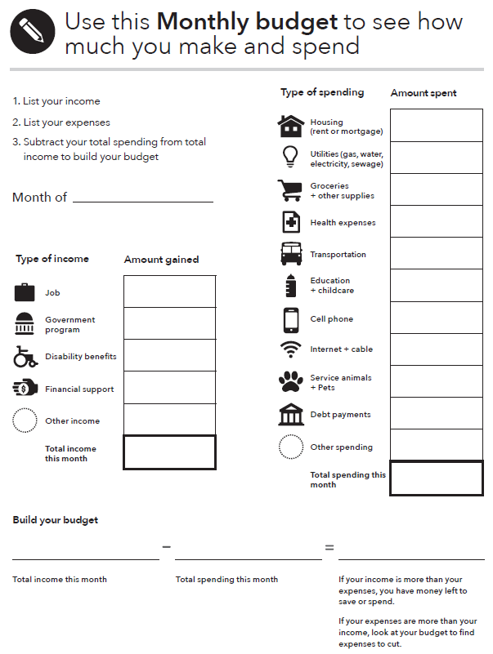
Tool: Monthly budget
Notes:
Instructions for Facilitator:
This is an image of the “Monthly budget” tool on page 43 in the guide.
Explain how to use the tool. Here is how you can explain it:
This tool allows a person to compare their income and spending side-by-side. Wherever possible, show the person you’re working with how to balance income and spending. The goal should be to have income higher than spending.
The instructions for this tool are to first, use the answers from the income tracker and spending tracker to complete the table or chart. Then, simply write the sources and uses of income and expenses for the month. This can help the person you’re working with understand whether their budget is running short, or how much extra they have in any given month.
If the budget is running short, it can help the person served understand where they may want to cut back on spending, especially discretionary items – or look for ways to increase income to help balance the budget.

Slide 41
Cash flow
What is a cash flow budget?
How is it different from a regular budget?
What do you think may be the benefit of this approach?
Notes:
Instructions for facilitator:
Cash flow is another topic covered in Module 5, starting on page 96 in the toolkit.
Explore what participants know about cash flow by asking: “What is a cash flow budget?”
After participants offer some ideas, share definition: A cash flow budget projects what money you expect to come in and how much you think you’ll spend each week and when you expect the expenses to occur.
Contrast cash flow to regular budget by asking: “How is a cash flow budget different from a regular budget?”
After participants offer some ideas, share definition: A cash flow budget tracks the timing of income and spending. This is key.
ASK: What do you think may be the benefit of this approach?

Slide 42
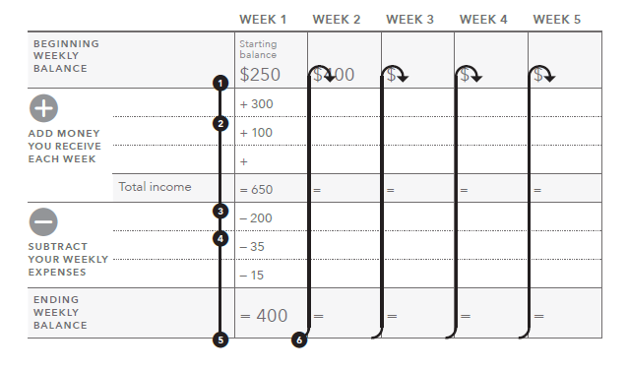
Tool: Creating a cash flow budget
Notes:
Instructions for facilitator:
See the corresponding section of the toolkit: “Creating a cash flow budget” tool in Module 5, pages 99-101
Review the components of a cash flow budget by explaining each step in the process and pointing out where that step is recorded on the tool:
Enter your starting balance for the month under Week 1. This is the total amount of money available to you from cash on-hand, prepaid cards, and checking and saving accounts.
Write down the amounts you receive during Week 1 from the categories listed. If you have income from other categories, add them together and write them under "Other."
Add up all your income for Week 1 and enter under "Total income."
Write down the amounts you spend during Week 1. If you have expenses from other categories, add them together and write them under "Other."
Subtract all the expenses for Week 1 from the "Total income" for Week 1. Write this amount in "Ending weekly balance."
Copy the amount from "Ending weekly balance" from Week 1 into the "Starting balance" for Week 2. Repeat steps 2 through 5 for the remaining weeks in the month.
FACILITATION TIP: Consider going through these instructions with the actual tool pulled up on the screen, typing in sample information in each section and showing the automatic calculation feature.

Slide 43
Managing cash flow: Scenario overview
Rafael is a single parent with two children.
He is often late with his rent and other bills, because he does not have the money when he needs it.
After tracking his spending, he developed a cash flow budget with an educator at a parenting class he takes through Cooperative Extension in his community.
Using the cash flow, make some recommendations to Rafael so he can make ends meet.
Notes:
ACTIVITY - Module 5: Getting through the Month
Methodology: Scenario Analysis
Corresponding section of the toolkit: Module 5
Instructions for facilitator:
Instruct participants to get into groups of three.
Review the introduction facts listed on this slide to describe the scenario they will analyze.

Slide 44
Managing cash flow scenario
Notes:
ACTIVITY - Module 5: Getting through the Month
Methodology: Scenario Analysis
Corresponding section of the toolkit: Module 5
Instructions for facilitator:
Make copies of this slide and distribute or transfer the information from this slide into the “Creating a cash flow budget” tool, print the third page, and distribute.
Additional information on the scenario
Rafael earns $14.65/hour and works 40 hours per week; he is paid every other week. (His net pay was calculated using an online calculator from ADP based on Oklahoma state tax laws. He is head of household, claims 3 federal exemptions, and has no voluntary deductions. The number was rounded up to $990.)
Credit card payment reflects minimum payment; personal loan is to grandmother (owes $2,000).
Rent includes utilities--electricity, gas, water, sewer, garbage pickup.
Part-time childcare is provided by family member at a big discount ($10/day to cover expenses for 7 days a week). This expense increases during the summer months when the kids are not in school (from $10/day to $25/day). However, during May, June, July, and August, the income from landscaping (his part-time job) doubles.

Slide 45
Cash flow analysis
When does Rafael run out of money?
What can he do (or try to do) to better match the timing of his income and his expenses? Develop a prioritized list.
How does the SNAP benefit factor into the cash flow?
The next month is not included in the example. What will Rafael’s situation be at the beginning of next month? How much cash will he have? What bills will he have? What should he do now to prepare for the following month?
Notes:
ACTIVITY - Module 5: Getting through the Month
Methodology: Scenario Analysis
Corresponding section of the toolkit: Module 5
Instructions for facilitator:
Instruct participants to analyze the cash flow and answer the first three questions above.
After 5 minutes, reveal the fourth question and instruct them to answer this within their groups.
Process as a large group:
When does Rafael run out of money? Answer: At the end of the first week.
What can he do (or try to do) to better match the timing of his income and his expenses? Develop a prioritized list. Possible answers:
See if landlord will accept rent payment the second week instead of the first.
See if the landlord will take half of the payment the first week of the month and half the third week of the month.
See if student loan payment can be moved to final week of the month. Explore other payment plans depending on type of loan such as Income Based Repayment.
See if auto loan payment can be moved.
How does the SNAP benefit factor into the cash flow? Answer: SNAP is important because it covers food; however, it makes it look like he has more cash during the first week than he actually does because SNAP can only be used for food.
The next month is not included in the example. What will Rafael’s situation be at the beginning of next month? How much cash will he have? What bills will he have? What should he do now to prepare for the following month? Possible answers:
His situation will be the same next month. He needs to get more income. First, he should make sure he is getting all of the benefits he and his family qualify for. Once this is done, he needs to consider getting more income from another part-time job.
ASK: Would a regular monthly budget highlight the shortfalls in cash?
Answer: No
Reason: Total income and benefits not including the starting cash balance is $3,272 for the month. Total expenses for the month $3167.22. While the budget is tight, a typical static monthly budget would show that everything is covered with a surplus of $104.78. This is the problem with a regular, static monthly budget.
Be sure to ask participants:
What do you think about this approach to budgeting versus the traditional approach? Be sure to discuss the week-by-week nature of this tool rather than the overall static monthly approach that might be presented by some financial educators.
What do you think are the potential benefits of using this approach with people? For yourself?
How did your opinion of this approach change after the case study?
What additional information do you need to feel comfortable with this approach to budgeting?

Slide 46
Module 6: Dealing with Debt
What is debt?
  Money you owe.
  Debt is a liability.
How is debt different from credit? For our purposes…
  Credit is the ability to borrow money.
  Debt can be the result of using credit.
Notes:
Instructions for Facilitator:
Introduce Module 6: Dealing with Debt. Module 6 starts on page 44 in the guide.
It helps individuals and families understand and navigate the world of debt: credit cards, student loans, short term loans, and other types of lending.
To start ask participants two key questions: “what is debt?” and, “how is that different from credit?”
Defining and separating these two concepts is very important for understanding issues of financial empowerment.
What is debt? Debt is money you owe. It is a liability, and it may obligate future income to be paid back.
How is that different from credit? For our purposes, credit means that you can borrow money. Debt, then, results from using credit. When you use credit, you create a liability.

Slide 47
Module 6 (continued)
Understanding debt, how to manage it, and how to reduce it are important components of financial empowerment.
Debt, however, is a reality for many people with and without disabilities.
People with disabilities may have debt related to:
  Paying for medical bills and assistive technology
  Buying, rehabilitating, adapting, or repairing a home
  Buying a car or truck or adapting it
  Starting a business
  Getting themselves or their children education and training
  Emergency expenses
Notes:
Instructions for Facilitator:
Use the following information to present the slide content:
Understanding debt, how to manage it, and how to reduce and get rid of it, are important components of financial empowerment.
Debt, however, is a reality for many people with and without disabilities.
There are many types of debt that people with disabilities may encounter. Some may be similar types of debt to those that people without disabilities have, and some may be connected to a person’s disability or related situation.
People with disabilities may have debt related to:
Paying for medical bills and assistive technology
Buying, rehabilitating, adapting, or repairing a home
Buying a car or truck or adapting it
Starting a business
Getting themselves or their children education and training, and
Emergency expenses
Explain that this list is not exhaustive. These are just some of the examples that are especially relevant to people with disabilities.
Module 6 in the toolkit contains several tools and handouts on debt, including a tool to be prepared to ask questions when debt collectors call. This can be found in the toolkit on pages 142 – 147.

Slide 48


Tool: Debt action plan
The two ways to reduce debt:
  Pay smallest debt first
  Pay highest interest rate first
Consider the pros and cons of each.
Notes:
Instructions for facilitator:
Have participants turn to the toolkit:
The “Debt action plan” tool is in Module 6, pages 130-131 of the toolkit.
Review two primary methods for reducing debt outlined in Tool 3:
Pay smallest debt first
Description: After you've made all your minimum payments, increase your payment on the smallest debt. After it's paid off, add that extra amount to your minimum payment on the next smallest debt.
Pro: If you have many small debts, you might see progress quickly by reducing the number of debts you owe.
Con: If the interest rate and fees are high on your larger debts and you pay the smaller ones first, you might pay more in total over the length of the debt.
Pay highest interest rate first
Description: After you've made all your minimum payments, increase your payment on the debt that has the highest interest rate. After it's paid off, add that extra amount to your minimum payment on the next highest-rate debt.
Pro: By paying off the debts that charge you the highest interest and fees first, you save money overall.
Con: You might not feel like you're making progress very quickly, especially if the first debt is large.

Slide 49
Handout: Total and Permanent Disability (TPD) Discharge
Many students with and without disabilities borrow money to pay for tuition, books, and other expenses. After an individual graduates and begins to pay off student loans, they have many repayment options.
Student loan borrowers with total and permanent disabilities have the right to have their entire federal student loan balance forgiven. This loan forgiveness occurs through process called TPD discharge.
Notes:
Instructions for Facilitator:
Explain that many people with and without disabilities borrow money to pay for tuition, books, and other expenses. After an individual graduates or ceases attending and begins to pay off student loans, they have many repayment options.
Explain that Module 6 in the toolkit provides information about many types of debt, including student loan debt and repayment options.
A program that is especially relevant to people with disabilities is the Total and Permanent Disability Discharge, or TPD.
The guide includes a handout on Total and Permanent Disability Discharge (TPD) on page 46. Student loan borrowers with disabilities who are eligible for TPD may have their federal student loan balance forgiven. To receive TPD discharge, borrowers must first prove their disability.

Slide 50
Tool: When debt collectors call
If you have questions about the debt, do not send money or even acknowledge the debt the first time you are contacted. Why?
  You want to make sure you actually owe the debt, and
  You want to make sure the individual contacting you really has the authority to collect the debt
Also, ask for the name, number and address for the debt collector and request information about the debt in writing.
If you're sued by a debt collector, be sure to respond to court documents.
Notes:
Instructions for facilitator:
See the corresponding section of the toolkit: The “When debt collectors call” tool in Module 6, pages 141-148
Review the list of questions to ask if a debt collector calls on page 142 of the “When debt collectors call” tool.
This tool also contains sample letters people can send to debt collectors to verify the debt or to request that they stop contacting them.
Remember, however, that stopping contact does not erase the debt.
Explain:
Debt collectors use persuasive techniques to get you to send in money to pay your debt. Before you send in money, you should confirm that you actually owe the debt. You should also confirm that the collection isn’t fraudulent and is legitimate.
You may be able to confirm this information during an initial or follow-up discussion with the debt collector, but be careful of fraudulent debt collectors. Make sure that you recognize the debt, and confirm that you have not already paid it.
When the phone rings:
Sometimes it’s hard to know if a caller is really a debt collector. To avoid falling victim to a scam, ask for the name, number, and address for the debt collector and request information about the debt in writing.
Be wary of sharing your personal information by phone. If a stranger asks for your Social Security number, date of birth, or bank account information, this can be a red flag.
Don’t ignore court documents. If you don’t respond to court documents, or if you don’t show up for a court hearing, the court will usually issue a money judgment against you. You may want a lawyer to advise or represent you at the hearing. To find a lawyer in your state to discuss debt collection with, visit www.consumerfinance.gov/askcfpb/1433.

Slide 51
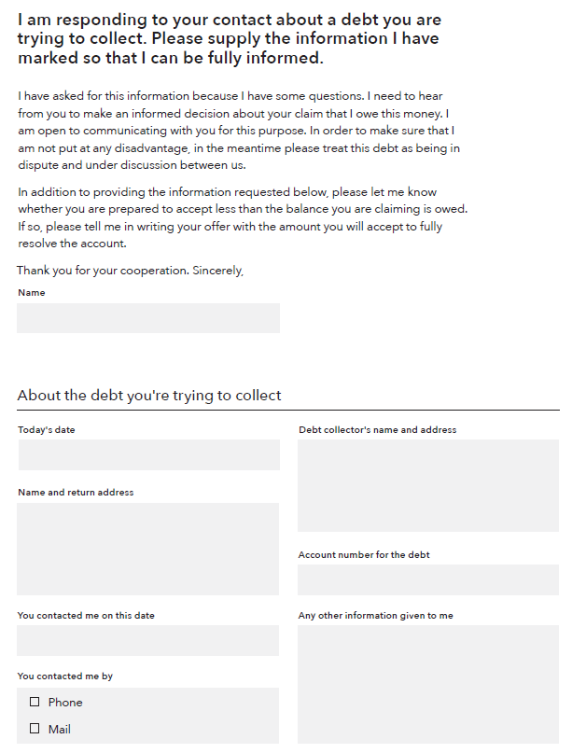
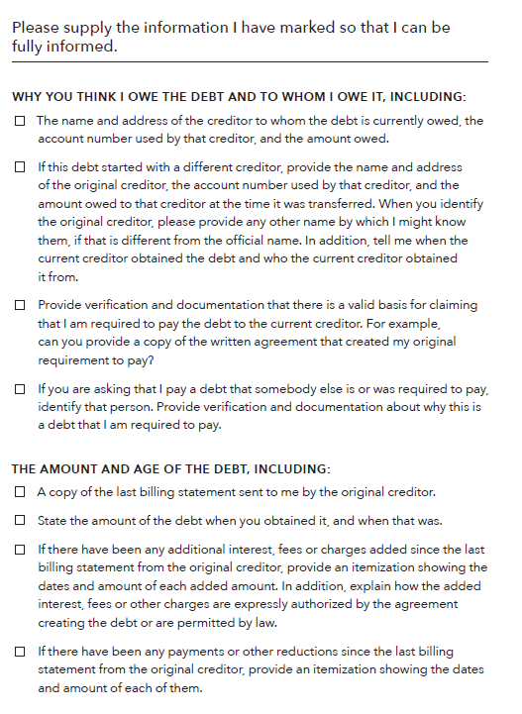
Verify the debt
Notes:
Instructions for facilitator:
See the corresponding section of the toolkit: The “When debt collectors call” too in Module 6, pages 142-148
Review the debt verification letter template and the dispute letter template.
FACILITATION TIP: Save a copy of this tool to your desktop before the training or find it online if you have an internet connection at your training site. Show the tool fillable fields.
Explain why it is important to ask for more information:
If you have questions about the debt, ask the debt collection agency for specific information before you send money or acknowledge the debt. You can do this by sending a “verification letter,” asking the debt collector to provide you with certain information regarding the debt. The letter you receive from the debt collector should contain a notice about your right to request more information about the debt.
Send this letter as soon as you can.
If you ask in writing before 30 days have passed, a debt collector has certain legal responsibilities to give you some information.
If the debt is not legitimate (if it's not yours or you already paid it), don't delay in disputing it.
Use the second letter template to send the debt collector a letter disputing the debt immediately. You may lose your ability to dispute the debt if you wait.

Slide 52
Know your rights
The Fair Debt Collection Practices Act protects consumers from harassment:
Repeated phone calls intended to annoy, abuse, or harass
Obscene or profane language
Threats of violence or harm
Publishing lists of people who refuse to pay their debts
Calling you without telling you who they are
Using false, deceptive, or misleading practices
Notes:
Instructions for facilitator:
See the corresponding section of the toolkit: The “When debt collectors call” in Module 6, pages 142-148.
Explain highlights of the Fair Debt Collection Practices Act.
The Fair Debt Collection Practices Act (FDCPA) says what debt collectors can and cannot do.
Under this law, a debt collector generally is a person or company that regularly collects debts owed to others, usually when those debts are past-due. These are often called “third party debt collectors.”
This law does not apply to individual or companies trying to collect their own debts.
The law states that debt collectors may not harass, oppress, or abuse you or any other people they contact. Some examples of harassment are:
Repeated phone calls that are intended to annoy, abuse, or harass you or any person answering the phone
Obscene or profane language
Threats of violence or harm
Publishing lists of people who refuse to pay their debts (this does not include reporting information to a credit reporting company)
Calling you without telling you who they are
The law also says debt collectors cannot use false, deceptive, or misleading practices. This includes misrepresentations about:
The debt, including the amount owed
That the person on the phone is an attorney (unless they are an attorney)
Threats to have you arrested
Threats to do things that cannot legally be done
Threats to do things that the debt collector has no intention of doing
Keep a file of all letters or documents a debt collector sends you and copies of anything you send to a debt collector.
Write down dates and times of conversations along with notes about what you discussed. These records can help you if you have a dispute with a debt collector, meet with a lawyer, or go to court.
ASK: When could you see using this tool? What obstacles do you anticipate in using this information?
We use “companies” in YMYG instead of businesses.

Slide 53
Module 7: Understanding credit reports and scores
A credit report is a record of an individual’s bill-paying history, public record information (such as a filing for bankruptcy), and prior inquiries by a creditor into the individual’s credit history at the time a consumer applies for credit.
Credit scores are calculated using the information in credit reports. A credit score is typically a number. A higher score makes it easier to qualify for a loan or to get a loan with lower interest rates. Many scores range from 300-850, but different scoring models may use different ranges of scores.
Notes:
Instructions for Facilitator:
Introduce Module 7: Understanding credit reports and scores on page 47 in the guide.
Module 7 provides information to individuals on how to access, review, and dispute errors in their credit report.
It is designed to help you and the people you serve understand what credit reports and scores are, what goes into them, and why they are important.
A credit report is a record of an individual’s bill-paying history, public record information (such as a filing for bankruptcy), and prior inquiries by a creditor into the individual’s credit history at the time a consumer applies for credit.
Credit scores are calculated using the information in credit reports. A credit score is typically a number. A higher score makes it easier to qualify for a loan or lower interest rates. Many scores range from 300-850, but different scoring models may use different ranges of scores.

Slide 54
Module 7 (continued)
Having a good credit history is an important part of an overall asset-building strategy that can help people reach their goals, including:
Get a job
Get an apartment
Get lower deposits on utilities and better terms on cell phone plans
Get a credit card
Get and keep a security clearance for a job
Notes:
Instructions for Facilitator:
Use the following information to present slide content:
Sometimes people may dismiss the importance of good credit if they don’t plan to get a credit card or loan.
A good credit history can provide access to lower cost financial products and other services.
Having a good credit history is an important part of asset-building and financial empowerment strategies that can help people reach their goals, including:
Getting a job
Getting an apartment
Getting insurance coverage
Getting lower deposits on utilities and better terms on cell phone purchase plans
Getting a credit card
Getting and keeping a security clearance for a job, including a military position

Slide 55
Credit scores: Example based on FICO
Notes:
Instructions for facilitator:
See the corresponding section of the toolkit: Module 7, pages 165 through166.
Explain:
Credit scores are calculated based on the information in your credit report.
Even though different credit scores have different mathematical formulas, they all use the information from your credit report.
While some pieces of information in your credit reports may be more important or less important, depending on which company is calculating your score, the key is to understand the information in your credit reports
Review the categories of information that influence a FICO score:
Payment history tracks whether you’re paying your bills on time. This is the biggest factor in your FICO scores. Paying bills late, not paying bills at all, and having bills that go to collections will likely cause your scores to drop. Paying your bills on time may help increase your scores.
Amounts owed tracks what you owe, including debts that you are paying down over time. It also includes your credit utilization rate, which is how much of your available credit you’re using. When the credit that’s available to you decreases because you’ve used a portion of it and now owe money, your scores may drop.
Length of credit history tracks how long you’ve had credit accounts—the longer the history, the more positive affect on your scores. A long credit history provides strong evidence of how you use credit and patterns of your payment behavior.
Types of credit used are also considered. For example, your FICO scores may increase if you have both revolving credit (such as credit cards) and other types of credit, such as a mortgage or an auto loan that you repay in installments, in good standing. Generally, it’s considered a good thing to have a mix of credit, such as a mortgage, an auto loan, and not too many credit cards.
New credit is tracked by measuring credit inquiries about you made by creditors and others. If there are too many inquiries, it may signal that you have a high demand for credit. Because this may be an indicator of risk, your scores may drop. Your scores are not affected at all when you check your credit reports yourself.

Slide 56
Legal representatives and credit reports; credit denials
If a person has a legal representative or court-appointed guardian, credit reports can be ordered by mail.
  Representatives must present certain information.
  Full list in Focus on People with Disabilities on pages 48-49.
If a lender or other organization denies a person a credit card or loan application, the lender or other organization is required under Equal Credit Opportunity Act (ECOA) to:
  Explain the specific reasons the application was rejected, or
  Explain that the applicant has the right to learn the reasons if asked within 60 days.
Notes:
Instructions for Facilitator:
Use the following information to present slide content:
Module 7, starting on page 47 in the guide, provides information on getting credit reports online or by mail. Anyone can request credit reports by mail or online. However, some people with disabilities have legal representatives or court-appointed guardians, which may include family members.
In the case that a person has a legal representative or court-appointed guardian, credit reports can be ordered by mail. Pages 48-49 in the guide include details on the specific pieces of information that must be included in a request for a credit report by mail.
If a lender or other institution denies a person a credit card or loan application, the lender or other institution is required under Equal Credit Opportunity Act (abbreviated ECOA) to:
Explain the specific reasons the application was rejected.
Explain that the applicant has the right to learn the reasons if asked within 60 days.

Slide 57
Credit discrimination is illegal
Credit discrimination is illegal. Under the Equal Credit Opportunity Act, a creditor can't discriminate in any credit transaction, including mortgages, against any applicant because of these factors:
  Receipt of income from any public assistance program such as Social Security Disability Insurance (SSDI) or the Supplemental Nutrition Assistance Program (SNAP)
  Race
  Color
  Religion
  National origin
  Sex
  Other
Notes:
Instructions for Facilitator:
Use the following information to present slide content:
Credit discrimination is illegal.
Pages 49 and 50 in the guide highlight how Under the Equal Credit Opportunity Act, a creditor can't discriminate in any credit transaction, including mortgages, against any applicant because of these factors:
Receipt of income from any public assistance program such as Social Security Disability Insurance or the Supplemental Nutrition Assistance Program
Race
Color
Religion
National origin
Sex (gender)
Marital status
Age, unless the applicant is not legally able to enter into a contract
Your exercising in good faith a right under the Consumer Credit Protection Act (such as disputing information in your credit report)
ECOA and Regulation B prohibit creditors from discriminating in any aspect of a credit transaction against an applicant because all or part of the applicant’s income derives from public assistance programs.
A creditor may be acting illegally if it treats applicants differently on a prohibited basis, for example, if it imposes additional documentation requirements on public assistance recipients not imposed on other applicants.

Slide 58
Module 8: Choosing Financial Products and Services
Your Money, Your Goals takes a financial empowerment approach to financial products and services.
Rather than direct people to a particular type of provider or service, this module starts with an assessment of their needs or priorities and – based on those needs – it helps the person decide how to choose among options.
Notes:
Instructions for Facilitator:
Introduce Module 8: Choosing Financial Products and Services.
Your Money, Your Goals takes a financial empowerment approach to financial products and services.
Rather than directing people to a particular type of provider or service, this module starts with an assessment of the individuals’ needs or priorities and – based on those needs – helps a person decide how to choose among multiple options. With this information, they can make the choices that are best for themselves and their family.

Slide 59
Many types of products and services
Module 8 helps people understand how to find and choose financial services, products, and providers that meet their needs.
Many types of financial products and services can help people:
  Protect their money and financial resources.
  Better manage their money.
  More efficiently pay for their current living expenses.
  Set aside money for their goals
Notes:
Instructions for Facilitator:
Explain that Module 8 in the toolkit helps people understand how to find and choose financial services, products, and providers that meet their needs. There are many types of financial products and services that can help people:
Protect their money and financial resources
Better manage their money
More efficiently pay for their current living expenses
Set aside money for their goals or for future generations
Briefly explain that Module 8 in Focus on People with Disabilities does not have any specific tools for people with disabilities. For information on financial tools, products and services, refer to the Your Money, Your Goals toolkit.

Slide 60
Module 9: Protecting your Money
When it comes to protecting your money and financial resources, there are laws that give you rights.
Module 9: Protecting your Money provides an overview of how to protect your identity and be alert for red flags.
This module also covers how to submit a complaint to the CFPB.
If someone feels uncomfortable submitting a complaint without assistance, another individual can submit a complaint on their behalf, with their consent.
Notes:
Instructions for Facilitator:
Introduce Module 9: Protecting your Money on page 53 in the guide.
This module highlights the importance of identifying and addressing financial abuse, fraud, and exploitation.
It explains what to do if identity theft and financial abuse have taken place.
It also provides information on how to submit complaints to the Bureau if the consumer has a problem with a financial product or service.

Slide 61
Module 9 (continued)
“Financial exploitation is the illegal or improper use of an individual’s funds, property, or assets.”
While many people are at risk of having their identity stolen, people with disabilities may face a higher risk of identity theft, financial abuse, and financial exploitation.
This can occur through fraud or scams, or when caregivers, family members, or others improperly use an individual’s financial resources.
Notes:
Instructions for Facilitator:
Use the following information to present slide content:
Financial exploitation is defined as the illegal or improper use of an individual’s funds, property, or assets.
While many people are at risk of having their identity stolen in general, people with disabilities may face a higher risk of identity theft, financial abuse, and financial exploitation.
This can occur through fraud or scams, or when caregivers, family members, or others improperly use an individual’s financial resources.
There are other circumstances that put people with disabilities at risk. By being aware of potential exploitation, it is possible to act quickly to protect a person’s financial well-being.

Slide 62
Disability: Risks for financial exploitation
The following circumstances or conditions may make a person at risk for financial exploitation:
Having regular income and accumulated assets
Being trusting and polite
Being lonely and socially isolated
Being reluctant to report exploitation by family member, caregiver, or someone they depend on
Fearing rejection or more retaliation by the exploiter
Being unfamiliar with managing financial matters
Having cognitive impairments that affect financial decision-making and judgment
Notes:
Instructions for Facilitator:
Present slide content.
Explain that the following circumstances or conditions may make a person at risk for financial exploitation:
Having regular income and accumulated assets
Being trusting and polite
Being lonely and socially isolated
Being reluctant to report exploitation by family member, caregiver, or someone they depend on
Fearing rejection or more retaliation by the exploiter
Being unfamiliar with managing financial matters, and
Having cognitive impairments that affect financial decision-making and judgment

Slide 63
Identifying financial abuse and exploitation
Identifying financial exploitation may be difficult.
Individuals may be reluctant to say anything about what is happening to them out of:
  embarrassment and shame,
  fear of reprisal,
  dependency on the perpetrator of the offense, or
  fear of further straining a family relationship.
Family members or close friends may be unaware of the situation or they may be the individuals committing financial exploitation or abuse.
Notes:
Instructions for Facilitator:
Module 9 includes a tool on “Identifying financial abuse and exploitation”. This tool starts on page 59 in the guide.
Explain that identifying financial exploitation may be difficult for a number of reasons:
First of all, individuals may be reluctant to say anything about what is happening to them out of embarrassment and shame, fear of reprisal, dependency on the perpetrator of the offense, or fear of further straining a family relationship.
Family members or close friends may be unaware of the situation regarding financial exploitation – or they may be the individuals committing financial exploitation or abuse.

Slide 64
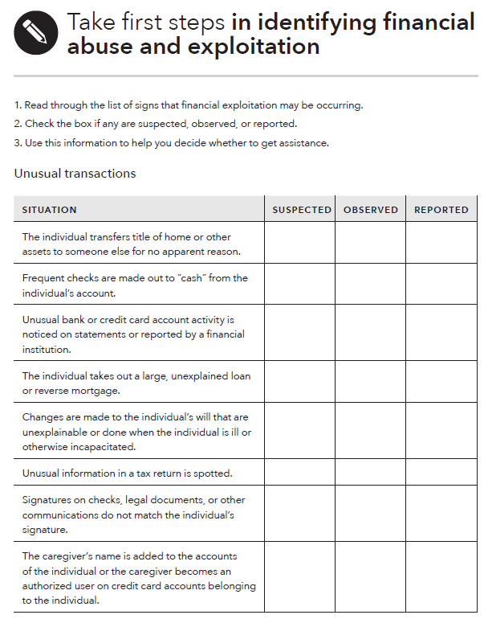
Tool: Identifying financial abuse and exploitation
Notes:
Instructions for Facilitator:
This is an image of the first part of the “Identifying financial abuse and exploitation” tool on page 60 in Focus on People with Disabilities.
Describe how to use the tool.
It provides instructions as well as the many types of situations that a person experiencing financial abuse and exploitation may encounter. Read through the list of signs that financial exploitation may be occurring; then check the box if any are suspected, observed, or reported; and finally use this information to help decide whether to get assistance.
The “Identifying financial abuse and exploitation” tool includes 3 main sections. Each one has a list potential examples of financial exploitation to watch out for, and report if needed.
The 3 main sections include the following:
Unusual transactions. For example, the individual takes out a large, unexplained loan or reverse mortgage.
Changed environment. For example, the living conditions are below expectations in spite of financial resources.
Unusual behavior. For example, the individual seems suddenly more fearful and becomes reluctant to talk about topics that were once routine conversations.

Slide 65
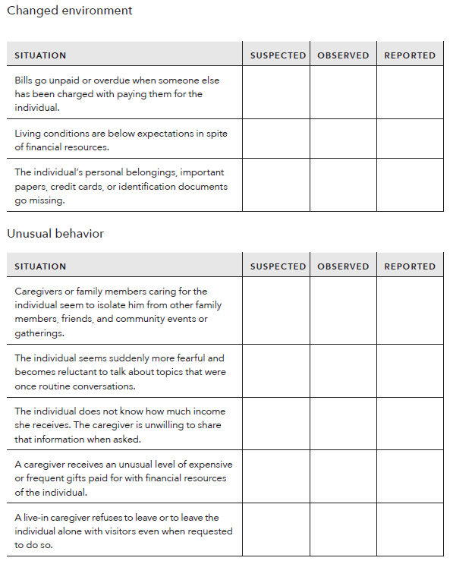
Tool: Identifying financial abuse and exploitation
Notes:
Instructions for Facilitator:
This is an image of the second part of the “Identifying financial abuse and exploitation” tool on page 61 in the guide.
Explain that it includes the last two sections of this tool.
The section on “Changed environment” includes “living conditions are below expectations in spite of financial resources” or some of “the individual’s personal belongings, important papers, credit cards, or identification documents go missing.”
The section on “Unusual behavior,” includes “individuals seem suddenly more fearful and reluctant to talk about topics that were once routine” or that the individual does not know how much income they receive and a caregiver is unwilling to share that information when asked.
Explain that this tool can be a useful resource for exploring and determining whether someone is in a dangerous situation. It can be valuable educational tool as you work with the people you serve – or as a tool for friends, family members, or other individuals who may be concerned about the safety and well-being of a person with a disability.

Slide 66
Resources
Financial abuse and exploitation
Financial exploitation often goes unreported because people do not know which steps to take.
List of resources that may help if you suspect financial abuse or exploitation:
  Contact your Adult Protective Services agency.
  Report financial fraud to your state’s attorney general’s office.
  Seek legal assistance for help with getting back money or property that was taken or to get protection from additional exploitation.
  Contact your local Area Agency on Aging if the individual is an older individual.
Notes:
Instructions for Facilitator:
Use the following information to present the slide content:
Financial exploitation often goes unreported because people do not know which steps to take, even if somebody would like to report it.
Remember, you do not need to prove that financial exploitation and/or abuse are occurring to report it. It is up to the professionals to take action if you suspect abuse.
Here is a list of resources that may help if you suspect financial abuse or exploitation.
Contact your Adult Protective Services agency.
Report financial fraud to your state’s attorney general’s office.
Seek legal assistance to help you with getting back money or property that was taken or to get protection from additional exploitation.
Contact your local Area Agency on Aging if the individual is an older individual.
There are other resources available the guide, including links and phone numbers to these agencies and for the Federal Trade Commission and Legal Services Corporation. You can also submit a complaint to the Bureau if the complaint is about a consumer financial product or service.

Slide 67
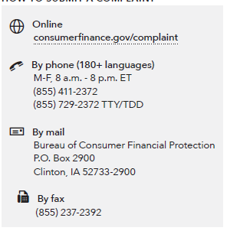
Handout: Submit a complaint
HOW TO SUBMIT A COMPLAINT
Notes:
Instructions for facilitator:
Refer participants to the CFPB complaint contact information on slide and in their toolkit, on page 240.
Explain that you can submit a complaint online, by mail, or over the phone by calling the CFPB at 855-411-2372, toll free. The TTY/TDD phone line for CFPB is 1-855-729-2372. U.S.-based call centers can help you in over 180 languages and can also take calls from consumers who are deaf, have hearing loss, or have speech disabilities. Live operators in Spanish are available.
You can submit a complaint on behalf of someone else following the directions on the site.
Explain the following:
An empowered consumer understands their rights. When you know you have rights, you can take steps to protect yourself. There are many laws that protect your rights when it comes to financial products and services. It is the CFPB’s job to enforce these laws and handle consumers’ complaints about financial products and services.
The CFPB has already handled over 1.5 million consumer complaints about:
Credit cards
Mortgages
Bank accounts and services
Student loans
Vehicle loans or leases
Payday loans
Other consumer loans (including installment loans, pawn loans, and title loans)
Debt collection
Money transfers or virtual currency
Credit reporting
Prepaid cards
Other financial services (including check cashing, money orders, cashier’s checks, credit repair, debt settlement, refund anticipation loans, foreign currency exchange, and traveler’s checks)
Every complaint the CFPB receives gives them insights into problems that people are experiencing in the marketplace and helps them to identify and prioritize problems for potential action.

Slide 68
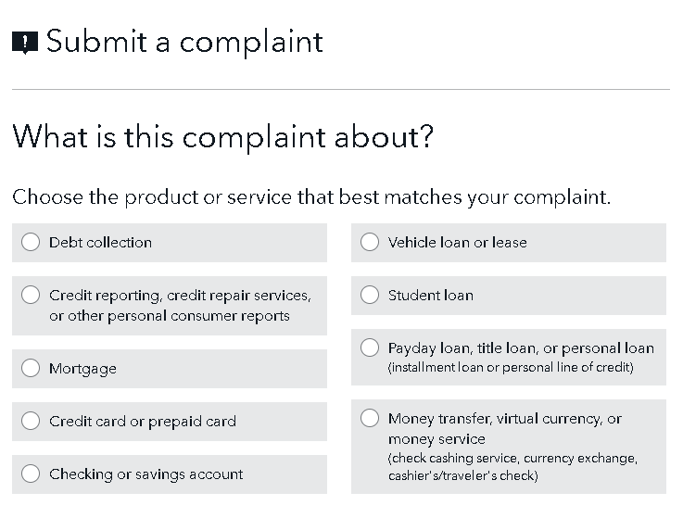
Submitting a complaint
Notes:
Instructions for facilitator:
Participants should see the corresponding section of the toolkit: The “Submitting a complaint” handout is in Module 9, page 240.
Review the steps in the complaint submission process. If possible, walk through the steps on the website https://www.consumerfinance.gov/complaint/
Step 1: What is this complaint about?
Step 2: What type of problem are you having?
Step 3: What happened?
Step 4: What company is this complaint about?
Step 5: Who are the people involved?
Be sure to highlight that someone can submit a complaint on behalf of another.

Slide 69
Thank you!
Notes:
Instructions for Facilitator:
Congratulate participants for having completed an in-depth training of Focus on People with Disabilities a companion guide to Your Money, Your Goals.

